Slide 1
Cleaning your data using Open Refine
Rebecca Olson, Business and Social Science Informationist
UC Libraries
Rebecca.olson@uc.edu, ASKDATA@uc.edu

Slide 2
What’s Open Refine?
Java based.
Once downloaded, is browser based, but connection to internet is not needed
Open Source

Slide 3

Objectives
Learn about messy data
Create a new project in Open Refine
Clean up data through using facets
Transform data formats
Automate changes

Slide 4
Data Collection is Messy.
Dec 1, 1917 | 1917-12-01
12/1/17 | 1917-12-01
1st of Dec | 1917-12-01
Dates, money, abbreviations, misspellings
10/31/19, October 31, 2019, 2019-Oct-31, 2019-10-31
$USD12.50, $12.50, 12 dollars and fifty cents
Number – no, numb, #
Color, colour, coloer, etc.
Formatting, white spaces, extra characters, multivalued cells.
.Cincinnati | Cincinnati
Cincinatti | Cincinnati
Cinci | Cincinnati

Slide 5
What can Open Refine do?
Clean
Transform
Extend
Automate
Tracks all changes, and easy to “undo”

Slide 6
Downloading and Installing
http://openrefine.org/
Open Refine 3.3 Final
Download workshop materials, especially ORMenu.csv
https://github.com/RebeccaOlson/UCL_Workshops

Slide 7
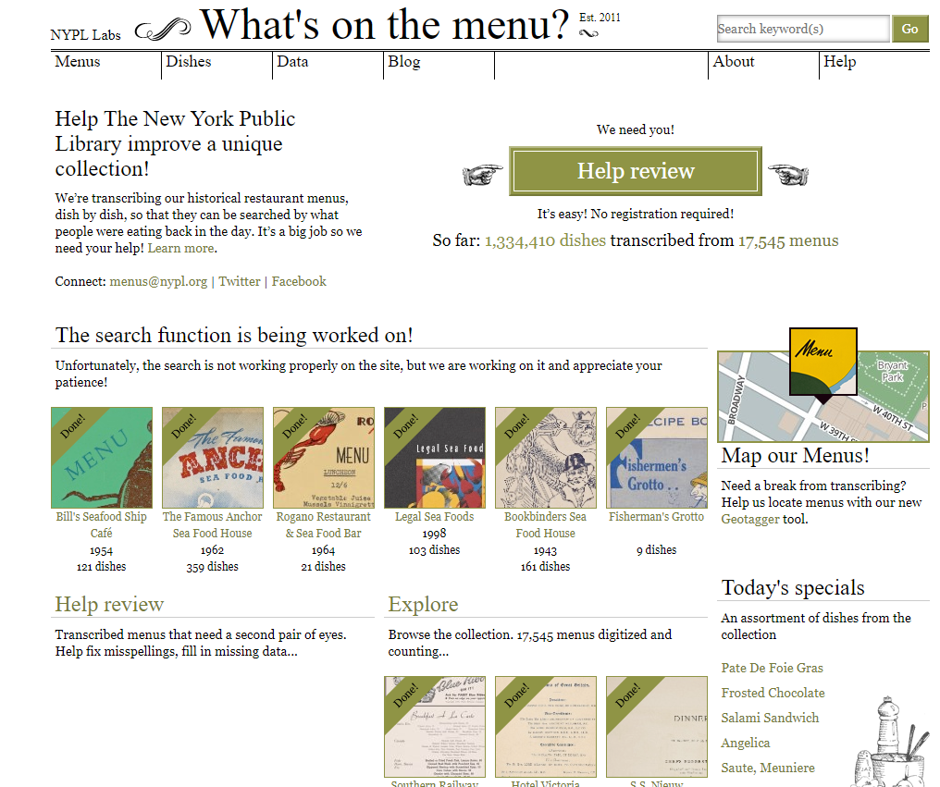
What’s on the Menu? NY Public Libraries
http://menus.nypl.org/
Collection of historic menus – transcription of every dish, every menu, every event.
Over 17,500 menus.
Data in CSV formats.

Slide 8
Let’s Try it out -
Open OpenRefine
Follow along with your handout.

Slide 9
Upcoming Workshops
Spreadsheet Best Practices #F1776
Tuesday, February 25, 2020
From 10:00 AM to 12:00 PM
Viz Lab in GMP Library Braunstein 240
Census data – Finding and using Census data #103652
Wednesday, March 4, 2020
From 10:00 AM to 12:00 PM
CECH Library classroom room 320
Data Analysis with Python #1236
Monday, March 2, 2020
From 1:00 PM to 3:00 PM
850D Baldwin - CEAS Library
Data Management Bingo - a Part of the Data and Computational Science Series #1480
Wednesday, March 4, 2020
From 12:30 PM to 2:30 PM
240H Braunstein Hall - Visualization Lab
Rebecca Olson, Business and Social Science Informationist
UC Libraries
Rebecca.olson@uc.edu, ASKDATA@uc.edu

